Slide 1





Team Griffin
Members
Lyudmil Nikodimov
Nikola Nenov
Emiliya Georgieva
Nikola Bogomirov
Plamen Paunov

Slide 2
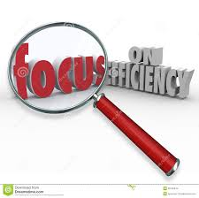
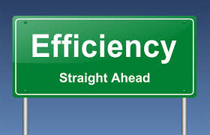
Efficiency Testing

Slide 3

ISTQB Glossary
Efficiency: The capability of the software product to provide appropriate performance, relative to the amount of resources used under stated conditions.
Efficiency Testing: The process of testing to determine the efficiency of a software product.

Slide 4
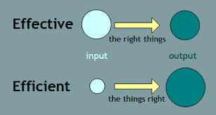
Effectiveness vs. Efficiency
Effectiveness is about doing or using the right things - things that yield positive results.
Efficiency is simply about doing things right - i.e., completing a task cheaper or faster.

Slide 5
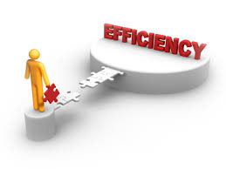
Efficiency
Efficiency is important in a number of situations:
Time-critical systems such as:
Most safety-critical systems
Real-time systems
Mission-critical systems
Even less critical systems like:
E-commerce systems
Point-of-sales systems

Slide 6
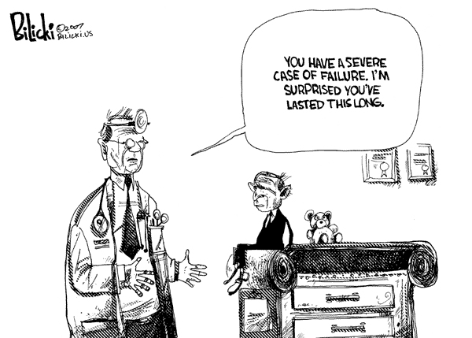
Efficiency Failures
Efficiency failures can include:
Slow response times
Inadequate throughput (rate of generating output)
Reliability failures under conditions of load, and excessive resource requirements

Slide 7
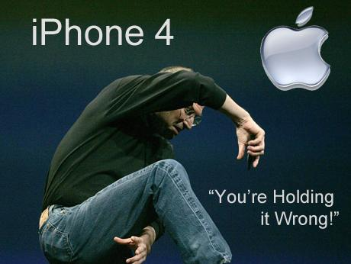
When is Efficiency Testing necessary?
Efficiency defects are often design flaws
Hard to fix during late-stage testing
Efficiency testing should be done at every test level
Particularly during design stage
Via reviews and static analysis tools

Slide 8
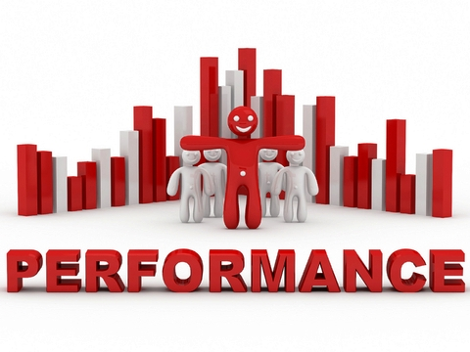
Performance Testing
Performance testing
Checks the ability of a component or a system to respond to user or system inputs
Within a specified period of time
Under different legal conditions
Can count the number of functions, records, or transactions that can be processed for a given time
Often called throughput

Slide 9
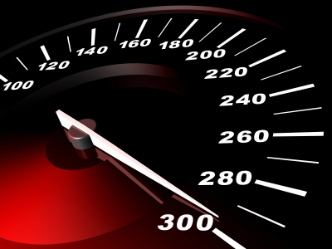
Load Testing
Load testing
Checks the behavior of the system in various mixes and levels of load
Usually focused on anticipated and realistic loads
Simulates transaction requests generated by certain numbers of parallel users

Slide 10
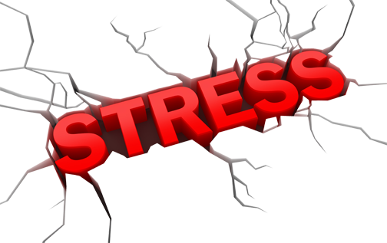
Stress Testing
Stress testing
Checks the system behavior when reaching and exceeding the maximum capacity and volume of the software
Ensuring that response times, reliability, and functionality decrease insensibly and predictably

